Slide 1

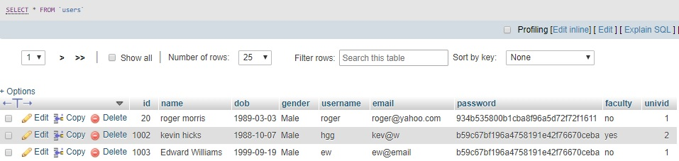
Accounts Database (phpMyAdmin View)

Slide 2
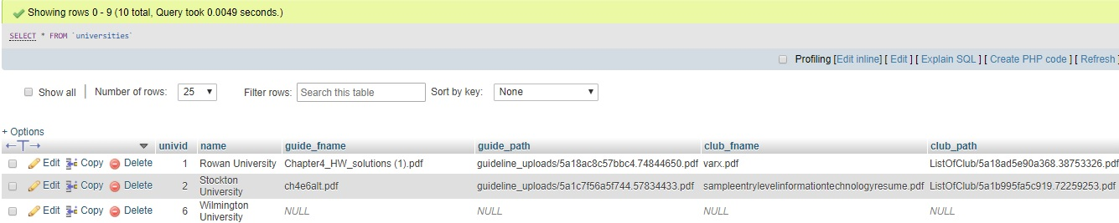
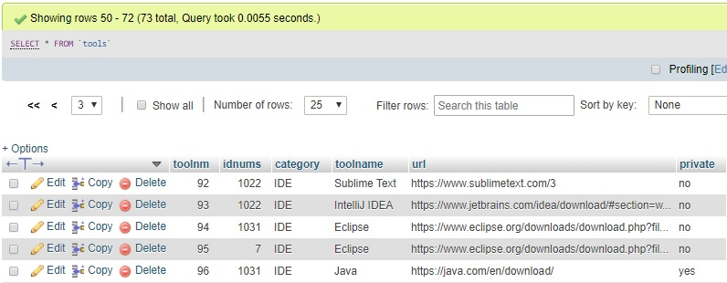
Accounts Database (phpMyAdmin View)

Slide 3
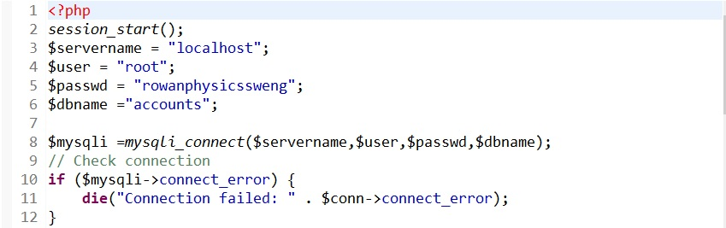

PHP Connection Code

Slide 4
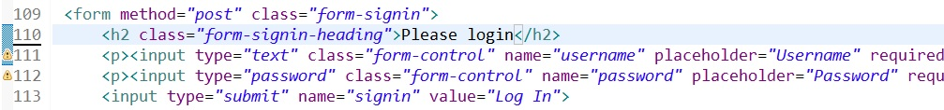
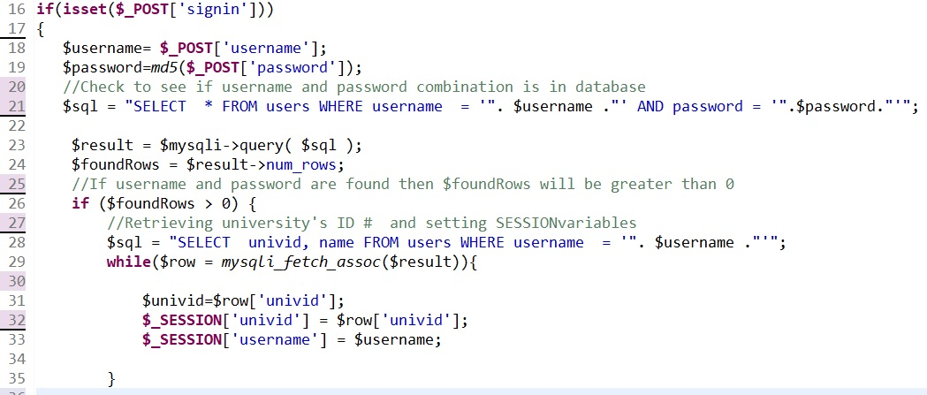
PHP Code for Obtaining User Input and Querying the Database

